Slide 1
Nos thesis meeting
Analysis of the sample data

Slide 2
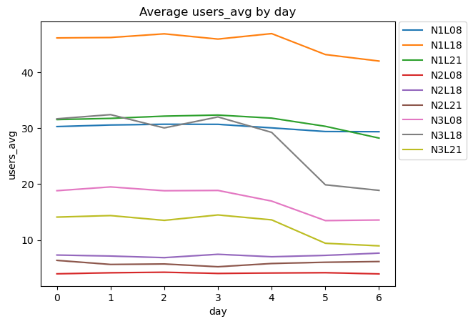
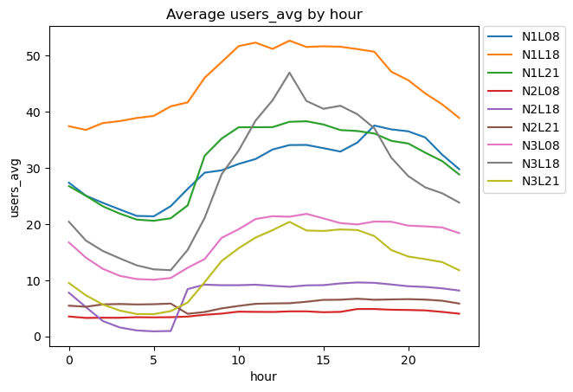
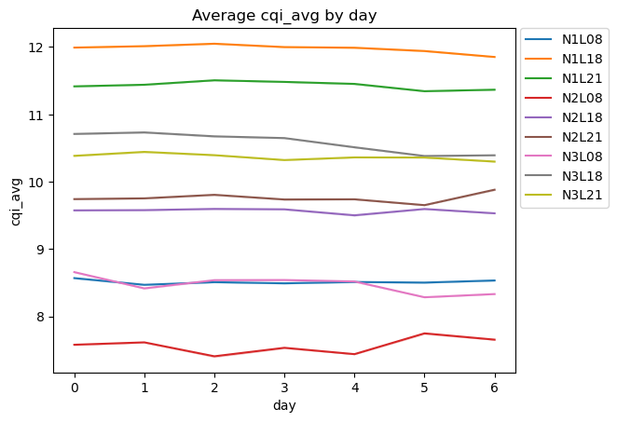
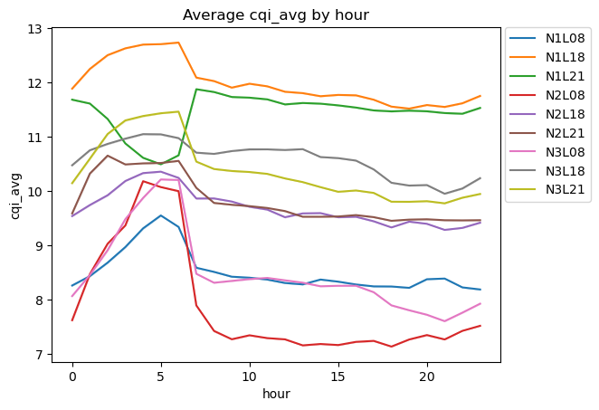

Slide 3
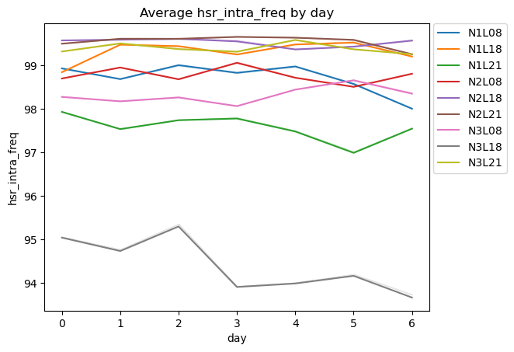
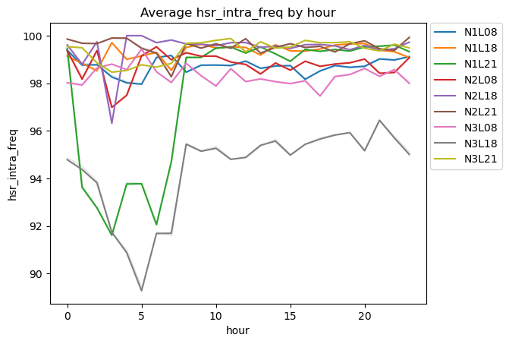
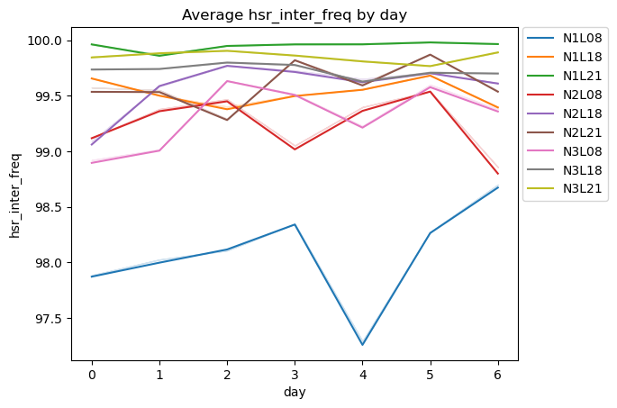
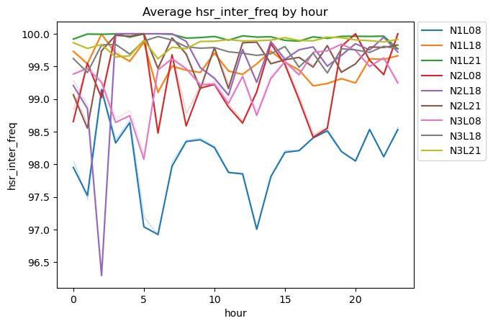

Slide 4
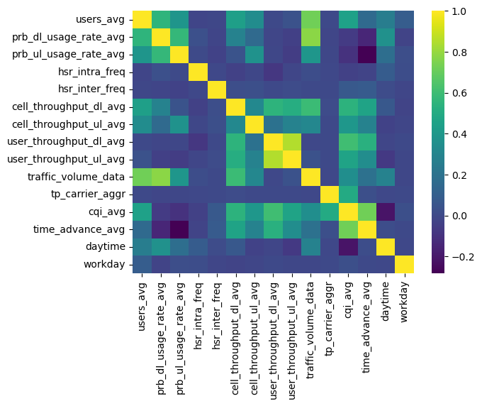
All KPIs correlations

Slide 5
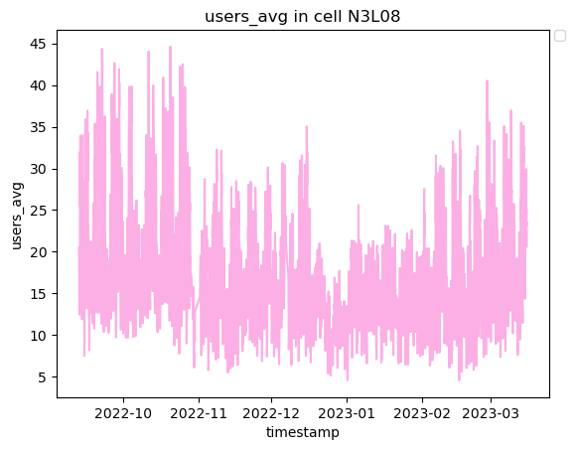
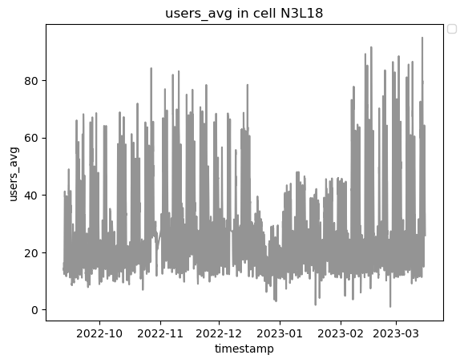
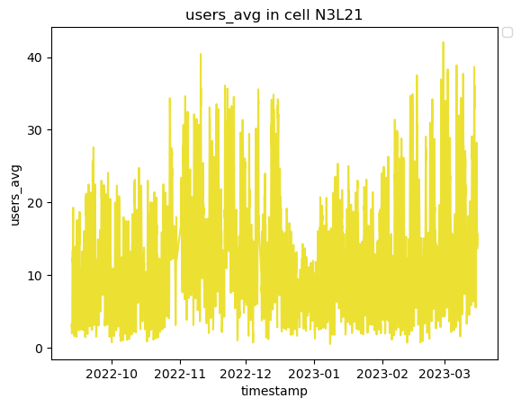
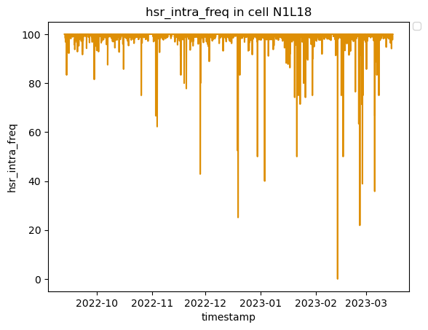
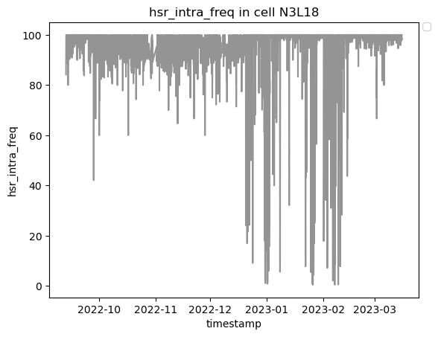
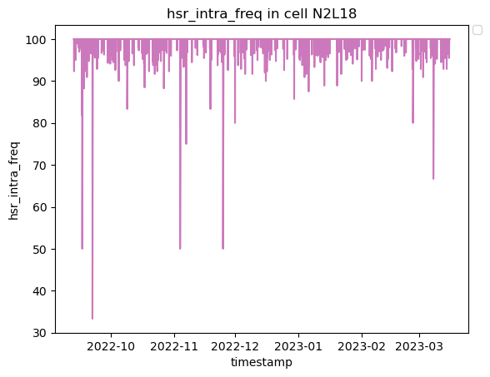
Sector
Frequency

Slide 6
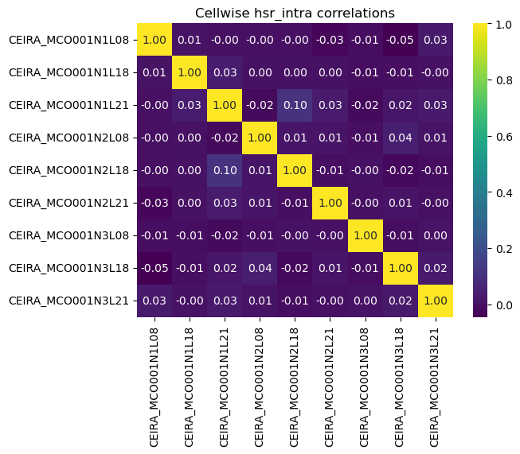

Cellwise handover correlation

Slide 7



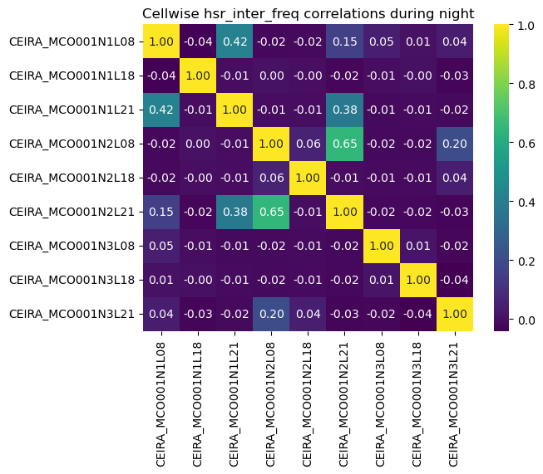
Do the cellwise HSR correlations increase during day or night?

Slide 8
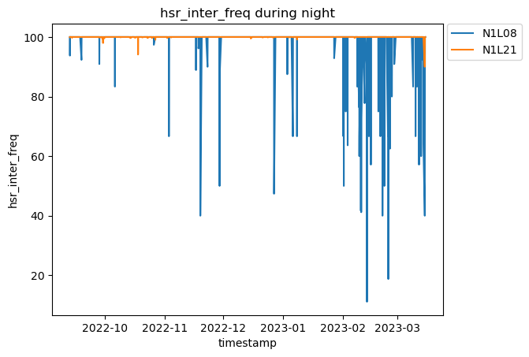
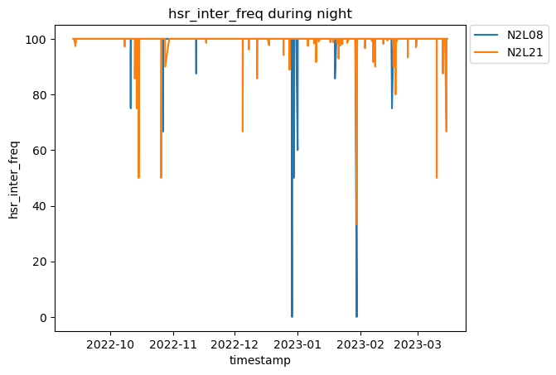
Is there a meaning behind the correlations?
Corr=0.42
Corr=0.65

Slide 9
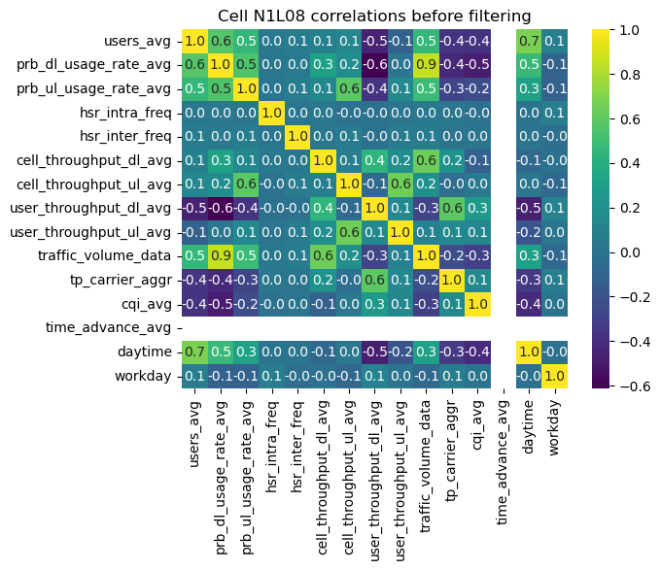
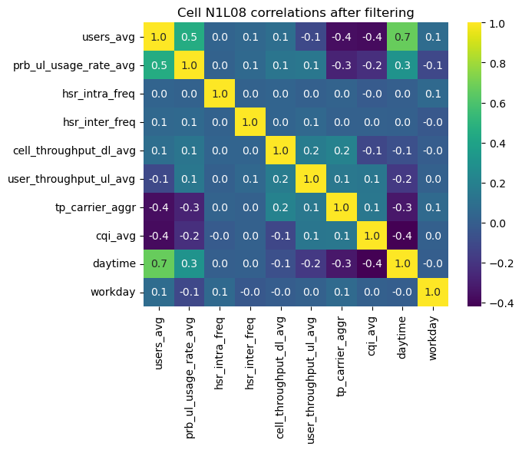
DBSCAN clustering to find normal and abnormal classes
Removing highly correlated features to avoid dimensionality problems

Slide 10
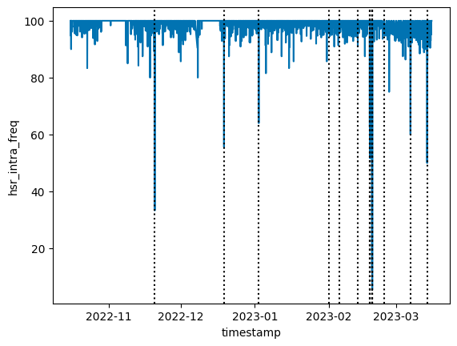

Datapoints labeled as ”anomalies” in cell N1L08 using DBSCAN
Most of the points with low intra-freq hsr are labeled anomalous.
From the 4 data points with intra-freq hsr = 100%, most had lowered inter-freq hsr:

Slide 11
Questions
The location of the BS?
Are HOs inbound or outbound?
Bandwidths used for different frequencies?
What to do with missing/zero values in data? Remove data points or insert values?
Filters/thresholds?
Confirming cluster labels?

